Slide 1
Federal Depository Library Program
GOVERNMENT INFORMATION WITHIN REACH
Brought to you by the Fifth Circuit Libraries.

Slide 2
WHAT IS THE FDLP?
The FDLP or the Federal Depository Library Program provides free government materials to participating libraries.

Slide 3
MISSION: To provide free, ready, and permanent public access to Federal Government information, now and for future generations.

Slide 4
HISTORY OF THE FDLP
The Federal Depository Library Program (FDLP) began in 1813. An act of Congress provided that one copy of the journals and documents of the Senate and House be sent to each university and historical society in each state. The Government Publishing Office (GPO) began administering it in 1895.

Slide 5
The GPO acquires information from government agencies and then disseminates it in digital and tangible formats to over 1150 federal libraries across the United States which are known as Federal Depository Libraries.

Slide 6
The Fifth Circuit Library is a selective depository library of 5.86%. This means we only select that percentage of all the federal documents available in the FDLP. Most of the selected documents pertain to legal and congressional information.

Slide 7
The Code of Federal Regulations, the United States Code and the Serial Set are examples of frequently used government publications in our library.

Slide 8
Some of these resources are available in more than one format. For example…

Slide 9
CODE OF FEDERAL REGULATIONS (CFR)
The CFR is the codification of the general and permanent rules published in the Federal Register.

Slide 10
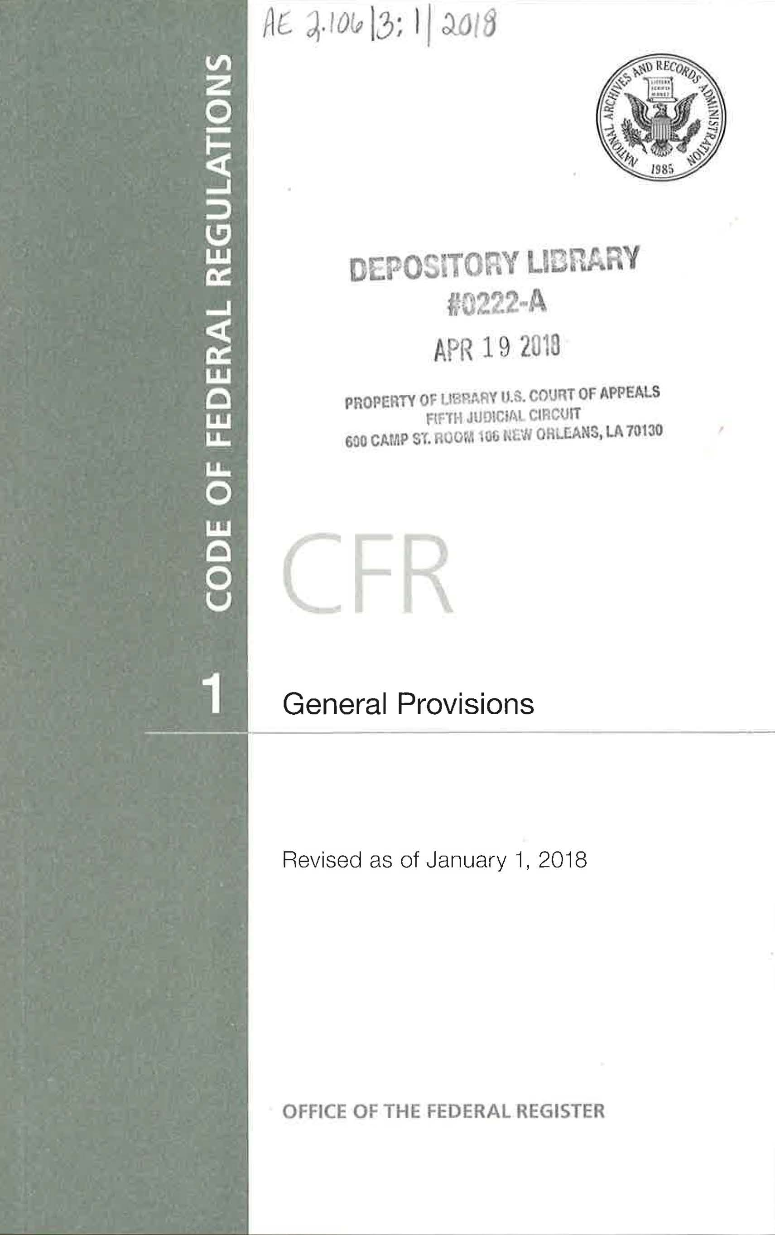
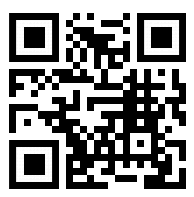
CODE OF FEDERAL REGULATIONS (CFR)
It is held by the Fifth Circuit Libraries.
It is also available online beginning with 1996:
https://www.govinfo.gov/help/cfr
Scan the QR Code to access the CFR online.

Slide 11
FEDERAL REGISTER
The Federal Register is the official daily publications of Federal Agencies.

Slide 12
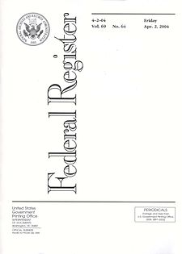
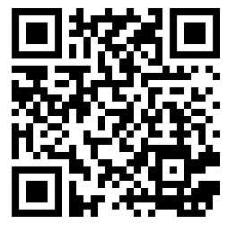
FEDERAL REGISTER
It is held by the Houston Library. The New Orleans Library holds issues up to 2017.
It is also available online beginning with 1936:
https://www.govinfo.gov/app/collection/FR
Scan the QR Code to access the Federal Register online.

Slide 13
But wait! What is this symbol?
This is a QR Code!

Slide 14
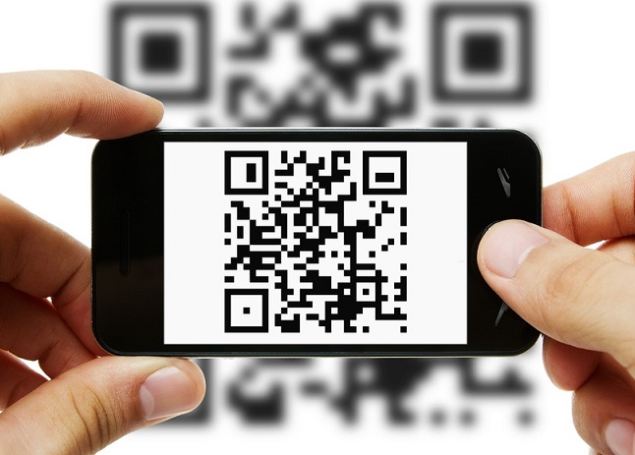
QR code stands for Quick Response Code. It is a type of two-dimensional barcode.
Using your QR code reader app on your smartphone, simply scan the QR code to access digital content.
There are many QR reader apps available for smartphones. Check your phone’s app store.

Slide 15
QR CODES IN THE LIBRARY
The New Orleans Library is introducing QR codes to the collection. In the stacks you will notice blue book stops that direct users to additional resources. Some of these contain QR codes that you can scan to access digital content.
Note that many of these titles have this sticker, which indicates that these are part of the FDLP.

Slide 16
As these QR codes demonstrate, government publications are found in many places on the web and it can be hard to remember where to look. One website that makes it easier to find many of these government publications is govinfo.gov.

Slide 17
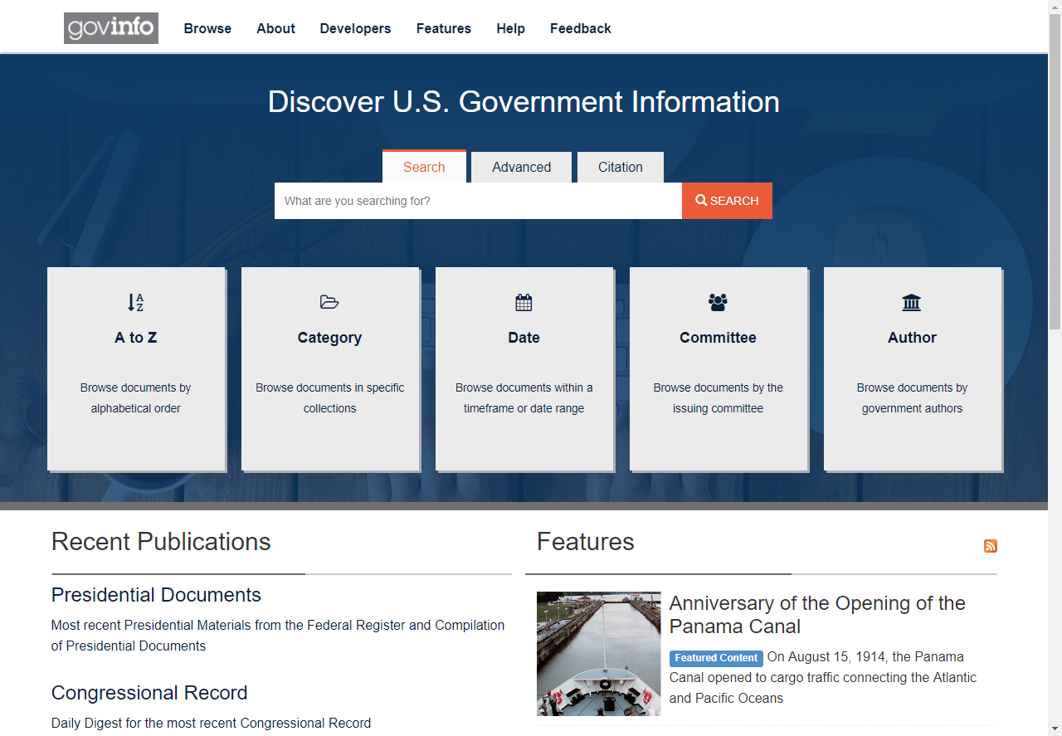
Govinfo.gov provides official publications from the United States government without charge. The website preserves content so that electronic documents are available for future generations.

Slide 18
WEBSITES OF INTEREST
Congress
https://www.congress.gov/
The Congressional website contains bills, committee reports, and calendars.
Department of State
https://www.state.gov/
The Department of State webpage has information on getting a passport, getting a visa, and travel advisories.
Department of Veterans Affairs
https://www.va.gov
The Department of Veterans Affairs website has benefits information, health care materials, and various other resources for veterans.
Food & Drug Administration
https://www.fda.gov/
The FDA webpage has information such as drug recalls, food safety, medical device approvals.
Internal Revenue Service
https://www.irs.gov/
The IRS website has tax forms, information on tax reform, refunds status, and much more.

Slide 19
WEBSITES OF INTEREST
National Archives & Record Administration
https://www.archives.gov/
The National Archives website provides instruction on how to search the Archives, a guide to federal records, online exhibits, and how to orders copies of records.
Social Security Administration
https://www.ssa.gov/
The Social Security Administration webpage provides information such as retirement benefits and social security cards and numbers.
United States Patent & Trademark Office
https://www.uspto.gov
The USPTO website contains a searchable trademark database, patent forms, and an overview of the patent process.

Slide 20
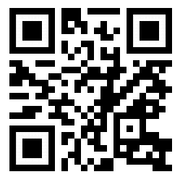
WANT TO LEARN MORE?
Check out https://www.fdlp.gov/

